Slide 1
Proposal summary Email

Slide 2
Proposal Summary Email
Make in same theme as our current CJ Emails
Email wireframe on next page
Send Email with Save Form (Whatever information is filled in) & Submit
Send email Real time, not with a delay. Send it as many times as the form is saved / submitted.
Sender Name : Travel Insurance @Policybazaar
Sender Email ID: communications@policybazaar.com
Subject : Your Travel Insurance Proposal form |Ref#:@LEADID

Slide 3
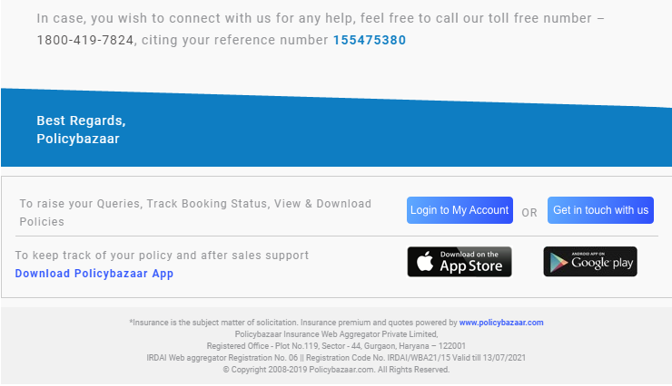
PB logo
Travel Insurance Proposal Summary
Dear @CustomerName,
Thanks for choosing Policybazaar for you Travel Insurance needs.
Please find below the summary of you proposal form.
Please review the details carefully before making payment , as the same will be printed on your policy document. (Incorrect proposal information may result in claim rejection in future)
Proposal Summary
Continue to Payment
For any assistance, simply reply back on this email without changing the subject line.
You can also connect with us on our toll free number 1800-419-7824 citing your reference number : @LEADID
Standard email Footer

Slide 4
Proposal Summary
1 box for each policy
Insure logo Plan Premium Insured member count
Proposer
Name
Gender
Date of Birth
Contact Details
Phone number: Masked mobile number (with Dialling code)
Alternate contact number:
Email id: Masked email id
Address:
Visa Type : (wherever we are sending to insurer only)
Purpose of Travel : (wherever we are sending to insurer only)
Insured 1
Name: Relationship to proposer :
Gender: Passport number:
Date of Birth: Marital Status:
PED: Other Additional questions:
Occupation: Nominee Name :
Nominee Relationship :
Repeat as many insured are there.
Club the data as above, but make it a 2 column grid to occupy least space on email

Slide 5
Student
Add the following in the insured box:
Course Details:
Course Name
University Name
University Address
Sponsor Information
Name
State
Date of Birth

